Slide 1
Kazan State Power Engineering University
ACCIDENT AT THE CHERNOBYL NUCLEAR POWER PLANT
Student: Vdovina N.S.
Teacher: Aitouganova Jh.I.
Kazan 2018

Slide 2
Objective: tell about the Chernobyl nuclear power plant accident.
Tasks:
Chernobyl Nuclear Power Plant;
causes of the disaster;
accident consequences;
interesting facts and myths.

Slide 3
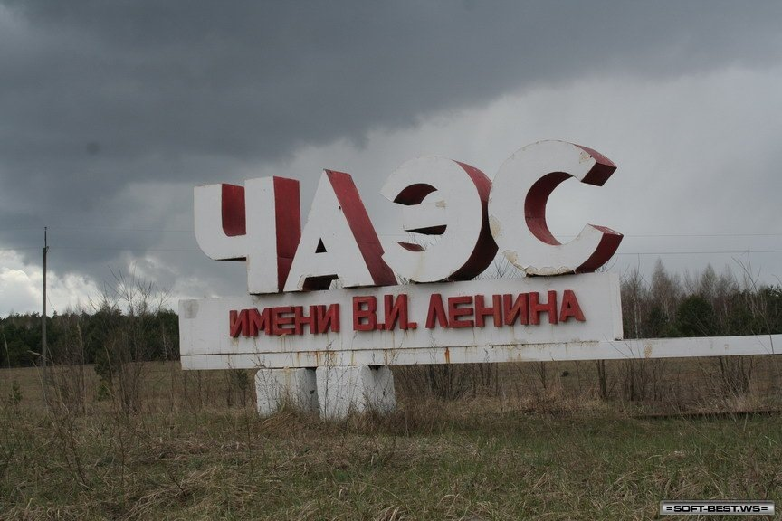
Chernobyl Nuclear Power Plant
The Chernobyl nuclear power plant is located in the eastern part of a large geographical region, on the bank of the Pripyat River, which flows into the Dnieper, 18 km from the district center - Chernobyl. Works on the construction of the station were started in 1970.
On August 21, 1984, the Chernobyl nuclear
power plant produced 100 billion kilowatt-hours
of electricity. Thus, on January 1, 1986, the
capacity of the four station blocks was 4
million kilowatts, which corresponded to
its design capacity.

Slide 4
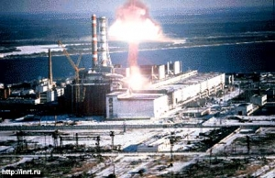
Сauses of the disaster
On the night of April 26, 1986, the personnel of the 4th unit of the Chernobyl Nuclear Power Plant in the process of preparing and conducting electrical technical tests violated the Regulations 6 times, roughly, rules for the safe operation of the reactor. Moreover, for the sixth time, at least 204 control rods out of 211 staff rods were withdrawn from its core.

Slide 5
we can briefly identify the six main causes of the accident at the 4th power unit:
decrease in the operational radioactivity reserve, that is, a decrease in the number of absorber rods in the reactor core below the allowable value
unexpected failure of the reactor power, and then the operation of the apparatus at a power lower than that established by the test program
connection to the reactor of all eight pumps with excess of costs
blockage of reactor protection by water level and vapor pressure in a separator drum
blocking of reactor protection on the signal of steam shutdown from two turbogenerators
shutdown of the protection system provided for in the event of a maximum design basis accident, - the emergency cooling system of the reactor

Slide 6
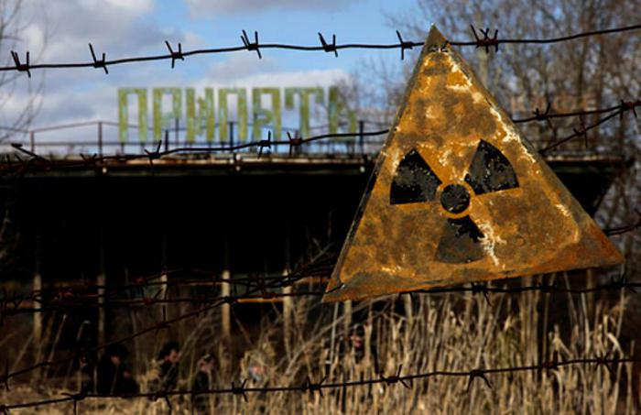
accident consequences
As a result of the accident, about 5 million hectares of land were removed from the agricultural turnover, around the NPP a 30-kilometer exclusion zone was created, hundreds of small settlements were destroyed and buried
Radioactive isotopes of plutonium and americium are retained in the soil for hundreds, and possibly thousands of years
Immediately after the disaster, 31 people died, and 600,000 liquidators who took part in extinguishing fires and clearing received high doses of radiation
5 to 30% of nuclear fuel was emitted into the environment

Slide 7
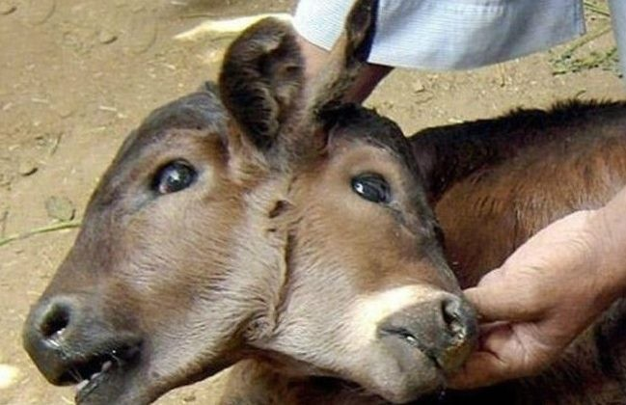
interesting facts and myths
Myth 1.
The genetic consequences for mankind of the accident at the Chernobyl nuclear power plant are terrible (the whole world science for 60 years of detailed scientific research has never observed any genetic consequences on the person due to radiation exposure)
Myth 2.
The resettlement of people from the city of Pripyat and surrounding areas was poorly organized, people can not be returned back to the zone (information that people received serious doses of radiation during evacuation is not true)
Myth 3.
Nature, the environment suffered from the accident at the nuclear power plant even more than man (the impact on nature was observed only next to the destroyed power unit, where there was irradiation of up to 2000 x-ray irradiation of trees)
Myth 4
The first major accident at the nuclear power plant was at the Chernobyl nuclear power plant (the first major accident of the nuclear power plant was an accident at the nuclear power plant "Three Mile Island" (Pennsylvania, USA) in 1979)

Slide 8
Internet resources
http://tass.ru/spec/chernobyl
https://www.chernobylwel.com/RU/884/
https://histrf.ru/lenta-vremeni/event/view/avariia-na-chiernobyl-skoi-aes

