Slide 1
"KAZAN STATE POWER ENGINEERING UNIVERSITY“ “technogenic catastrophes”
students:
Muratov Rafis
Vasfiev Ravil
AT-1-17
Teacher:
Aitouganova Jh.I
Kazan,2018

Slide 2
Target
Tasks to show
Tell about major technogenic catastrophes in Russia.
When it happened.
Effects.
Measures.

Slide 3
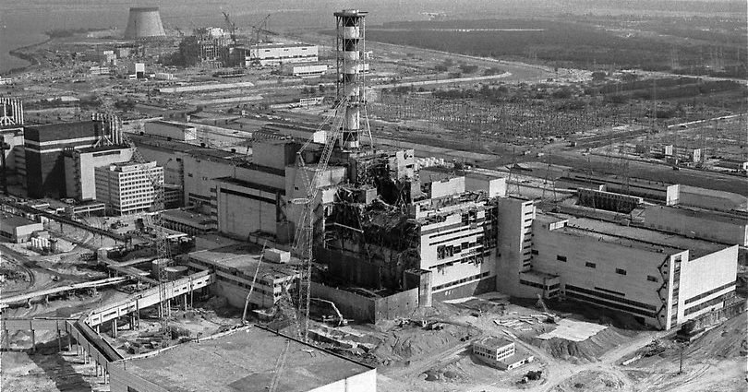
information
On the 26th of April 1986 a catastrophe broke out 12 kilometres off the Belarusian border. It was the major break-down of the power unit at the Chernobyl nuclear power station. It is the most severe catastrophe throughout the entire world history of the atomic energy use by its scale, complexity and long-term consequences.

Slide 4
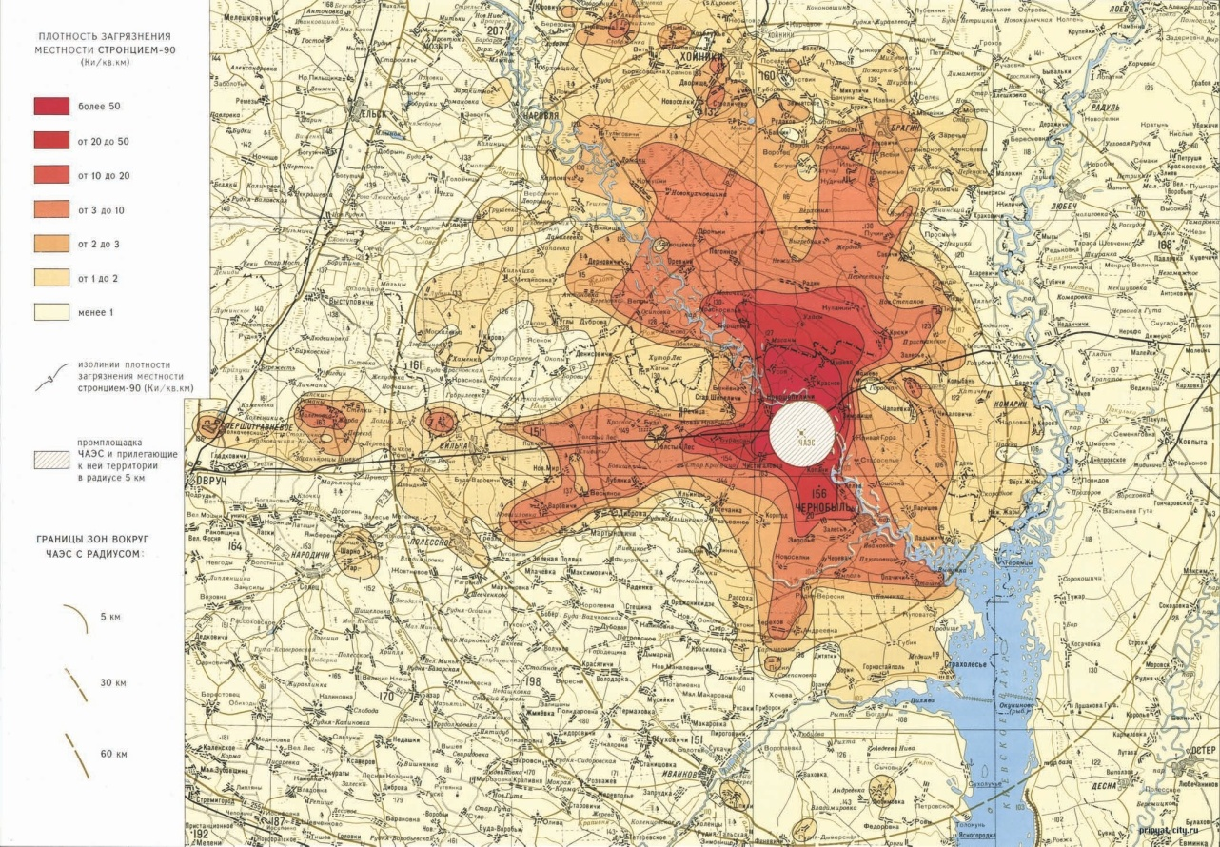
Effects
As the result of the explosion of the failed reactor a huge amount of radioactive substances were released into the atmosphere. Later on they left the large fall-out «spots» on the ground surface. 23% of the territory of Belarus, 4,8% of the territory of the Ukraine and 0,5% of the territory of Russia were contaminated.

Slide 5
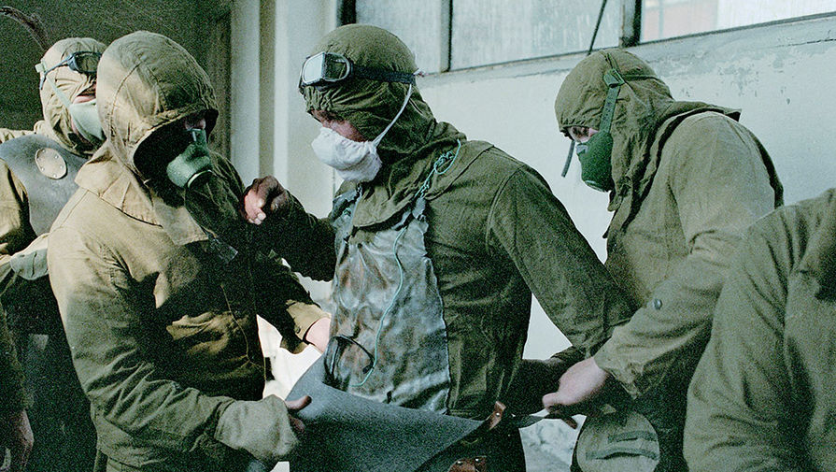
Effects
After the Chernobyl accident Belarus has become the zone of the ecological disaster. The situation got worse because radioactive contamination coincided with the formerly existing zones of high chemical pollution. 260,000 hectares of agricultural lands are forbidden to use for farming purposes. Thousands of hectares of forests are contaminated with radioactive elements. The Chernobyl catastrophe has affected the destinies of millions of people.

Slide 6
Measures
In order to decrease the influence of radiation on the people considerable work was done during the post-accident period/Measures were taken to evacuate the people from the most dangerous districts, to provide for their medical check-up and treatment. Various measures were carried out — radioactive decontamination, agricultural treatment of soil, provision of clean food. However, these measures are not enough yet. And international co-operation in this field serves the interests of the entire mankind.

Slide 7
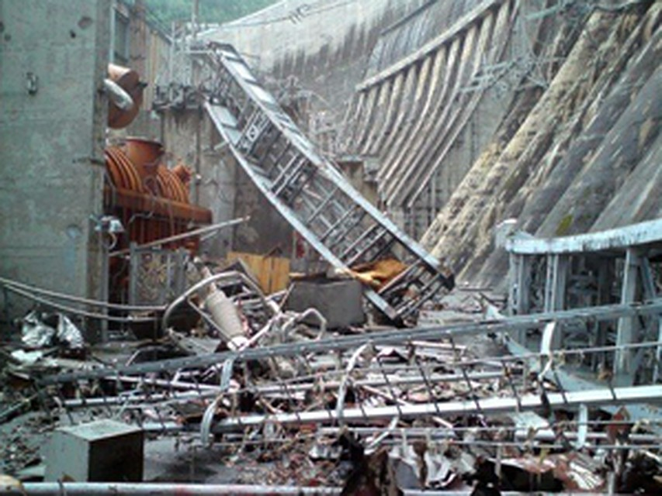
information
On 4 October 2009, the official report about Sayano–Shushenskaya hydro accident was published by the Federal Environmental, Technological and Atomic Supervisory Service (Rostekhnadzor) on its website.However, later the report and the press release on the report were removed from the website.

Slide 8
Effects
The accident caused an oil spill, releasing at least 40 tonnes (39 long tons; 44 short tons) of transformer oil which spread over 80 km (50 mi) downstream of Yenisei. The oil, which spilled during the approximately 2-3 hour cutoff of river flow when all the gates of the dam were closed, killed 400 tonnes (390 long tons; 440 short tons) of cultivated trout in two riverside fisheries, with its impact on wildlife as yet unassessed. On 19 August 2009, the 15 km (9.3 mi)-long spill had reached Ust-Abakan, where it was cordoned off with floating barriers and chemical sorbents. The oil spill was fully removed by 25 August 2009.

Slide 9
Measures
The replacement of damaged turbines will take up to four years. Over 2,000 people were involved in the rescue work and liquidation of the consequences after the disaster. According to Russian Energy Minister Sergei Shmatko, the rebuilding of the engine room alone will cost 40 billion rubles (€880 million, US$1.3 billion).
On 11 November 2014 the renovations and repairs were fully completed

Slide 10
resources
https://ru.wikipedia.org/wiki/Авария_на_Саяно-Шушенской_ГЭС
https://ru.wikipedia.org/wiki/Чернобыльская_АЭС

