Slide 1
Washington D.C.
KAZAN STATE POWER ENGINEERING UNIVERSITY
Student: Shaydullin D.
Teacher: Aitouganova Jh.I.

Slide 2
OUR TARGETS AND TASKS
Target
Tasks
Formation of ideas about the capital of the United States, its attractions, making it famous.
Tell information about: Washington, museums, monuments, libraries.

Slide 3
Content
Washington DC
Museums
Libraries
Monuments and sculptures

Slide 4
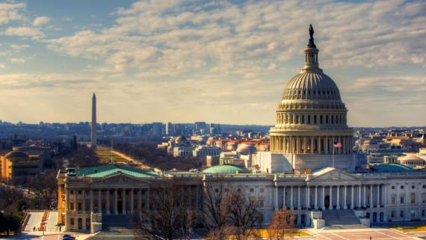
Washington, D.C.
Washington - city, capital of the United States. The official name is district of Columbia. The Federal district of Columbia is a separate territory from any state. The city of Washington was founded in 1791 and named after George Washington, the first American President.

Slide 5
Museums of Washington
Corcoran gallery of art
The President Lincoln's cottage
International spy Museum
Art gallery of Freer
City Museum of Washington
Museum of journalism and news
National art gallery
The us Holocaust memorial Museum

Slide 6
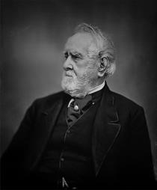
The Corcoran gallery of art is a private art Museum in Washington, D.C., with one of the most comprehensive collections of American art. The gallery was founded in 1869 by William Wilson Corcoran. It is one of the oldest private cultural institutions in the United States capital. The main emphasis in the gallery is made on American art.

Slide 7
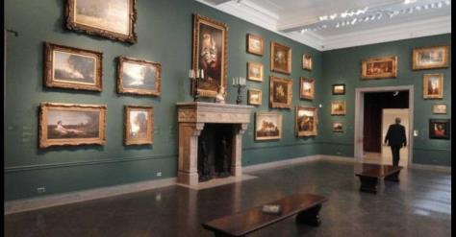
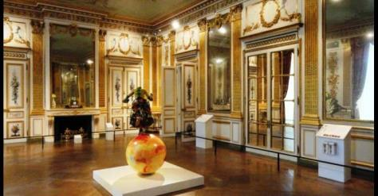
Initially, the gallery was located in a building on Pennsylvania Avenue, which currently houses the art gallery Renwick Gallery. Construction of this building began before the Civil war. During the war, it was used as a warehouse, and in 1874 opened a gallery. In 2014, the Museum was liquidated by court decision, its building was transferred to the University of George Washington.

Slide 8
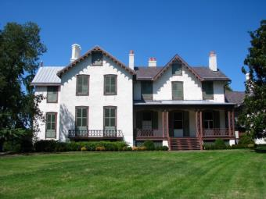
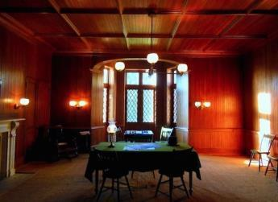
President Lincoln cottage
President Lincoln cottage is a national monument of the United States, located in the suburbs of Washington. Created on the basis of the Soldier's House. The cottage was built in 1843 in the new Gothic style. The Lincoln family lived in a cottage in order to avoid the political pressure that might be when staying in the center of the city.."

Slide 9
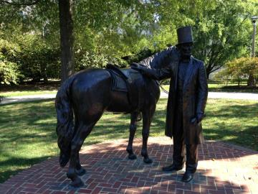
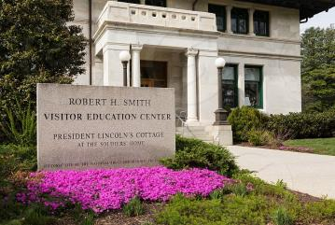
Lincoln settled in the cottage after President James Buchanan. Lincoln lived in the cottage from June to November between 1862 and 1864. In the first summer spent in the cottage Lincoln wrote a draft Proclamation on the release of slaves. The wife of President Mary Lincoln warmly recalled the time spent in the cottage, in 1865, she wrote that "tenderly loved the Soldier's house.

Slide 10
Libraries of Washington
Seattle Public Library
Library of Congress
Folger Shakespeare library
Puyallup Public Library
Spokane Public Library
Richmond Beach Library

Slide 11
Seattle Public Library
The Seattle Public Library is the public library system serving Seattle, Washington. It was officially established by the city in 1890, though there had been efforts to start a Seattle library as early as 1868.

Slide 12
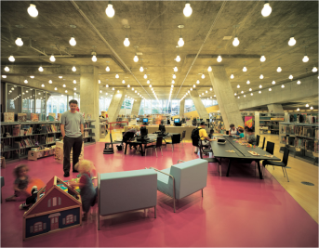
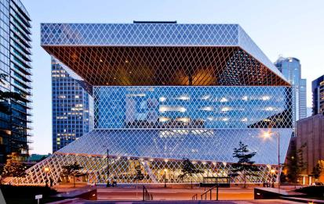
There are 26 branches in the system, most of them named after the neighborhoods in which they are located. Also included are Mobile Services and the Central Library. The Seattle Public Library also founded, and until July 2008 administered, the Washington Talking Book & Braille Library.

Slide 13
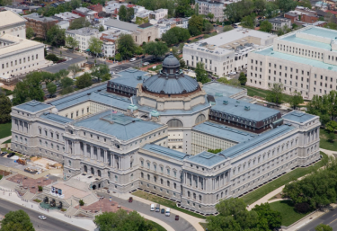
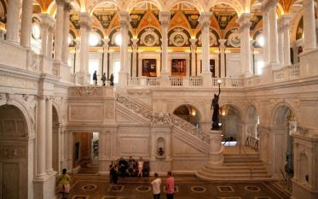
The Library of Congress
The library of Congress is the national library of the United States, the largest library in the world. Located in Washington, DC. Is a scientific library of the U.S. Congress, serving government agencies, research institutions, researchers, private firms and industrial companies, schools. It was founded on April 24, 1800, when US President John Adams signed the law on the transfer of the state capital from Philadelphia to Washington.

Slide 14
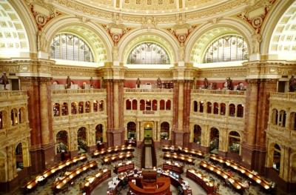
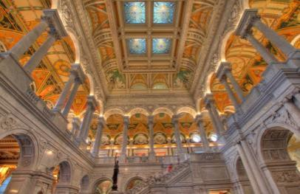
The library of Congress has 18 reading rooms on the 1460 seats for readers. The library of Congress bibliographic records contain the most significant "the National Union Catalog", issued monthly since 1958, and a consolidated catalog of books stored in libraries in the United States. The Russian Bureau of the library is located in Moscow.

Slide 15
Monuments and sculptures
Washington Monument
Lincoln memorial
Jefferson Memorial
A Monument To Martin Luther King
Korean War veterans memorial

Slide 16
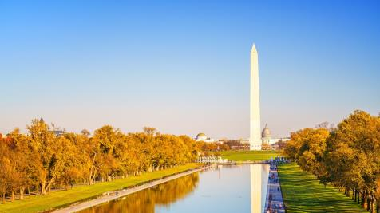
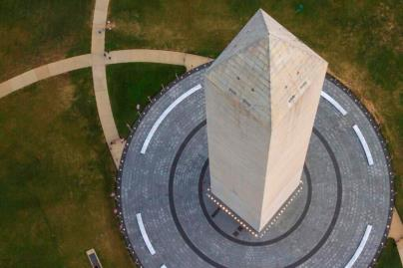
Washington Monument
Washington monument-lined with Maryland marble granite obelisk height of 169 meters and a mass of 91 thousand tons. Was erected in 1848-1884 in Washington, between the White house and Capitol, designed by Robert mills as a monument to the first President of the United States, George Washington.

Slide 17
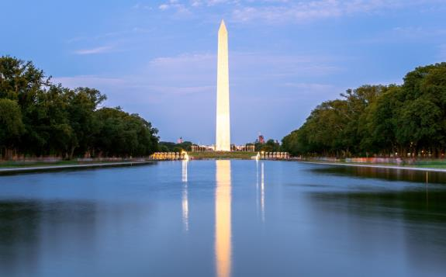
Prior to the construction of the Eiffel tower was the tallest structure on earth. On the East side at the top of the monument carved two Latin words "Laus Deo", which means "Praise God."

Slide 18
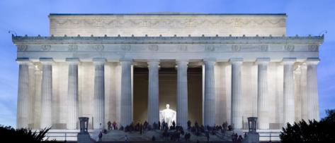
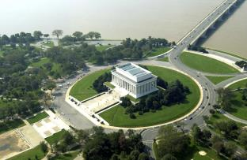
Lincoln memorial
Lincoln memorial is a memorial located on the national Mall in Central Washington. It was built in honor of the sixteenth US President Abraham Lincoln. His presidency was during the Civil war (1861-1865). The memorial, erected in 1914-1922, symbolizes Lincoln's belief that all people should be free. Compositionally, the building symbolizes the Union.

Slide 19
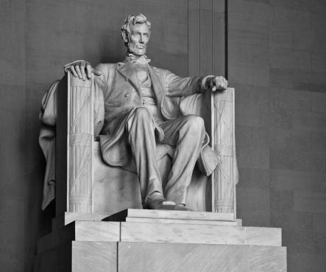
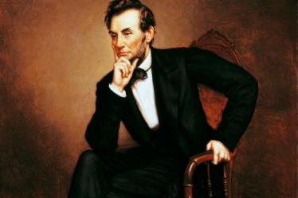
Around the perimeter are 36 columns — so much of the United States by the time of Lincoln's death. In the center of the memorial is a statue of Lincoln by Daniel Chester French, who used photos of Matthew Brady and portrayed the sitting President with a thoughtful face, whose eyes are turned to the monument to Washington and the Capitol.

Slide 20
Sources
https://yandex.ru/images/
https://ru.wikipedia.org/wiki/

