Slide 1
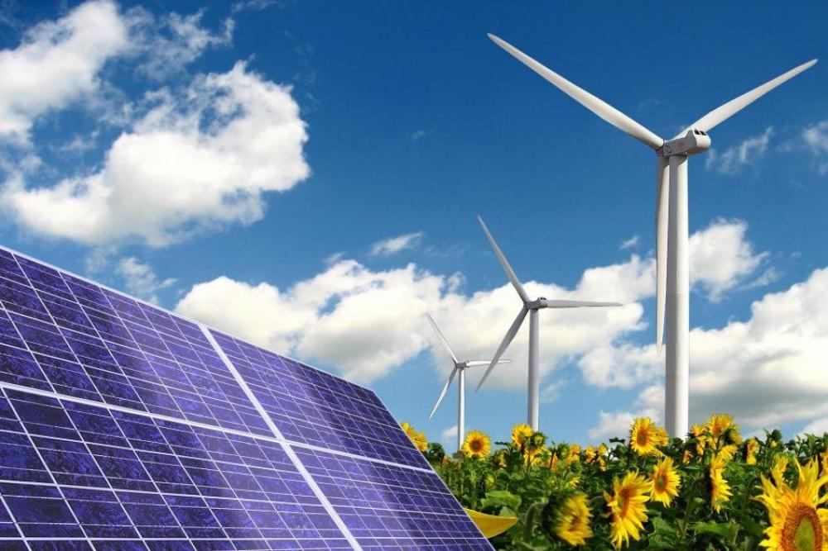
Alternative energy source
Performed by : Nigmatullina Vasilya gr.ЭЭ-6-19

Slide 2
Alternative energy sources
Wind energy
Hydropower
Geothermal energy
Solar power
Bioenergetics
Hydrogen energy

Slide 3
Wind energy
Solar power
Wind power is an energy industry that specializes in the use of wind energy — the kinetic energy of air masses in the atmosphere.
Wind power uses the force of the wind to drive the blades of wind turbines. The rotation of the turbine blades is converted to electric current by an electric generator.
Solar energy is the energy of the sun , it is an almost infinite source while our star is shining. Thousands of joules of heat are streaming in our direction. Solar energy is usually used for heating, cooking, electricity generation, and even in the desalination of seawater. The sun's rays are captured by solar installations and the sunlight is converted into electricity, heat.

Slide 4
Hydropower
Geothermal energy
Hydro-energy – the energy of falling water , and ways to convert it into electricity. Generating electricity from moving water is one of the cleanest and most affordable renewable energy sources. This is a good viable option if you live on a river with a fairly steady stream.
Geothermal energy is a branch of energy based on the production of electric and thermal energy at the expense of thermal energy contained in the earth 's interior, at geothermal stations. It is considered renewable energy .

Slide 5
Hydrogen energy
Bioenergetics
Bioenergy is an electric power industry based on the use of biofuels from various organic substances, mainly organic waste. Organic materials from plants or animals can be used to create energy that can be converted into electricity. Obviously, the process of burning all that 's bad for the environment, but also organic substances burn much cleaner than fossil fuels.
Hydrogen energy is an actively developing type of energy , energy production and consumption is based on the use of hydrogen, which in turn is formed when water decomposes.

Slide 6
Alternative energy sources in Russia

Slide 7
Conclusion
Alternative energy sources such as solar and wind can help reduce energy costs. Read about existing alternative energy technologies and how future energy sources will help you maintain your home efficiently .Alternative or renewable energy sources show significant promise in reducing the amount of toxins that are byproducts of energy use. Not only do they protect against harmful by-products, but using alternative energy sources saves many of the natural resources that we currently use as energy sources.

