Slide 1
Лекция №7

Slide 2
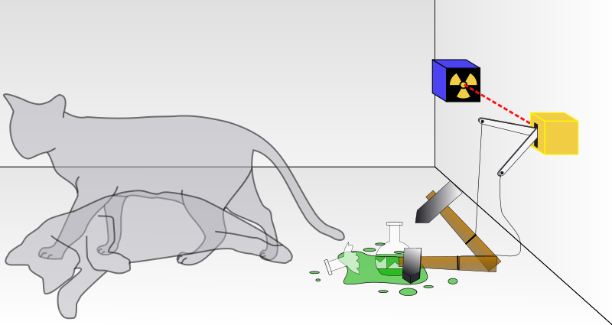
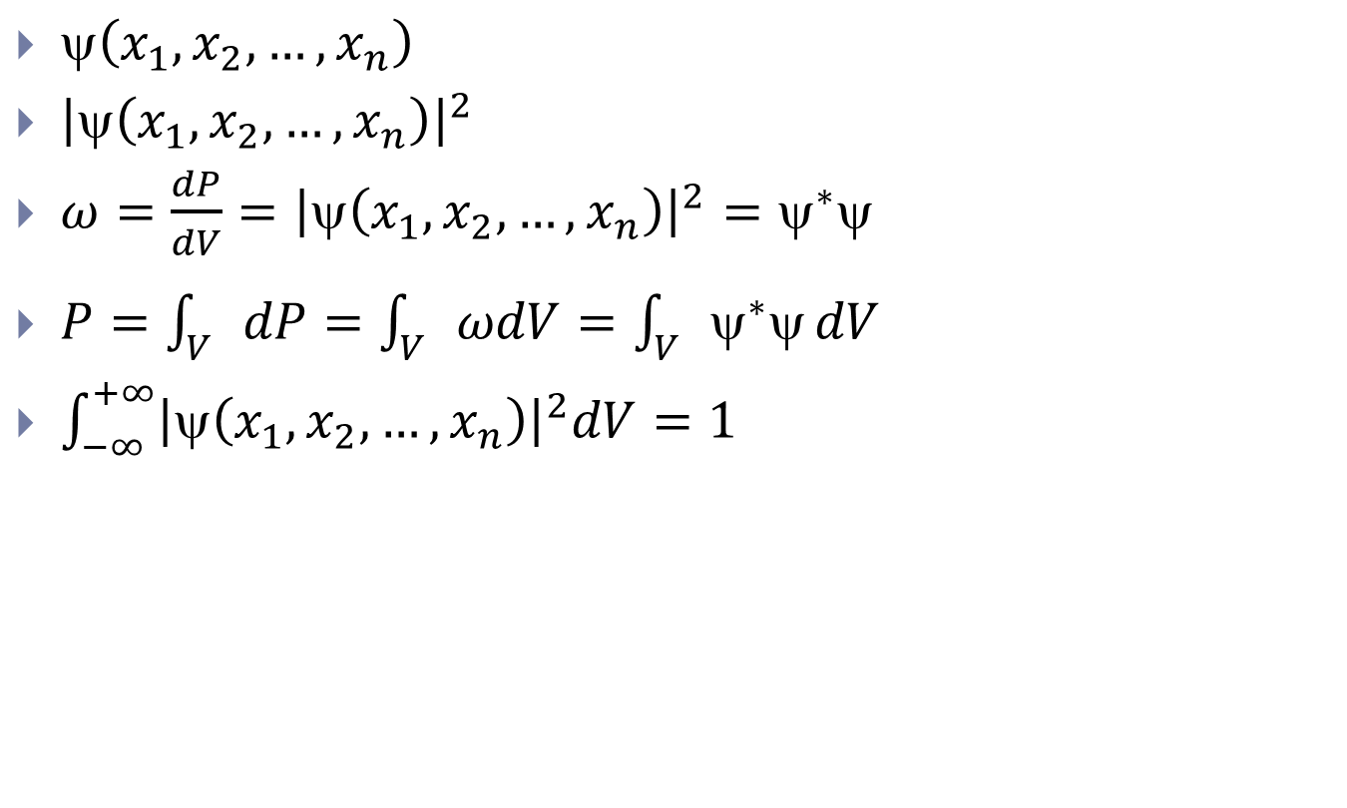
Волновая функция
$\text{y}\left(x_{1},x_{2},…,x_{n}\right)$
${\left|\text{y}\left(x_{1},x_{2},…,x_{n}\right)\right|}^{2}$
$ω=\frac{dP}{dV}={\left|\text{y}\left(x_{1},x_{2},…,x_{n}\right)\right|}^{2}={\text{y}}^{∗}\text{y}$
$P=\int_{V}{dP}=\int_{V}{ωdV}=\int_{V}{{\text{y}}^{∗}\text{y}}dV$
$\int_{−∞}^{+∞}{{\left|\text{y}\left(x_{1},x_{2},…,x_{n}\right)\right|}^{2}dV}=1$

Slide 3
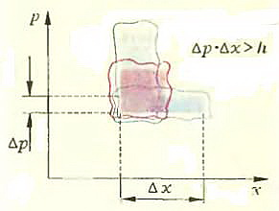
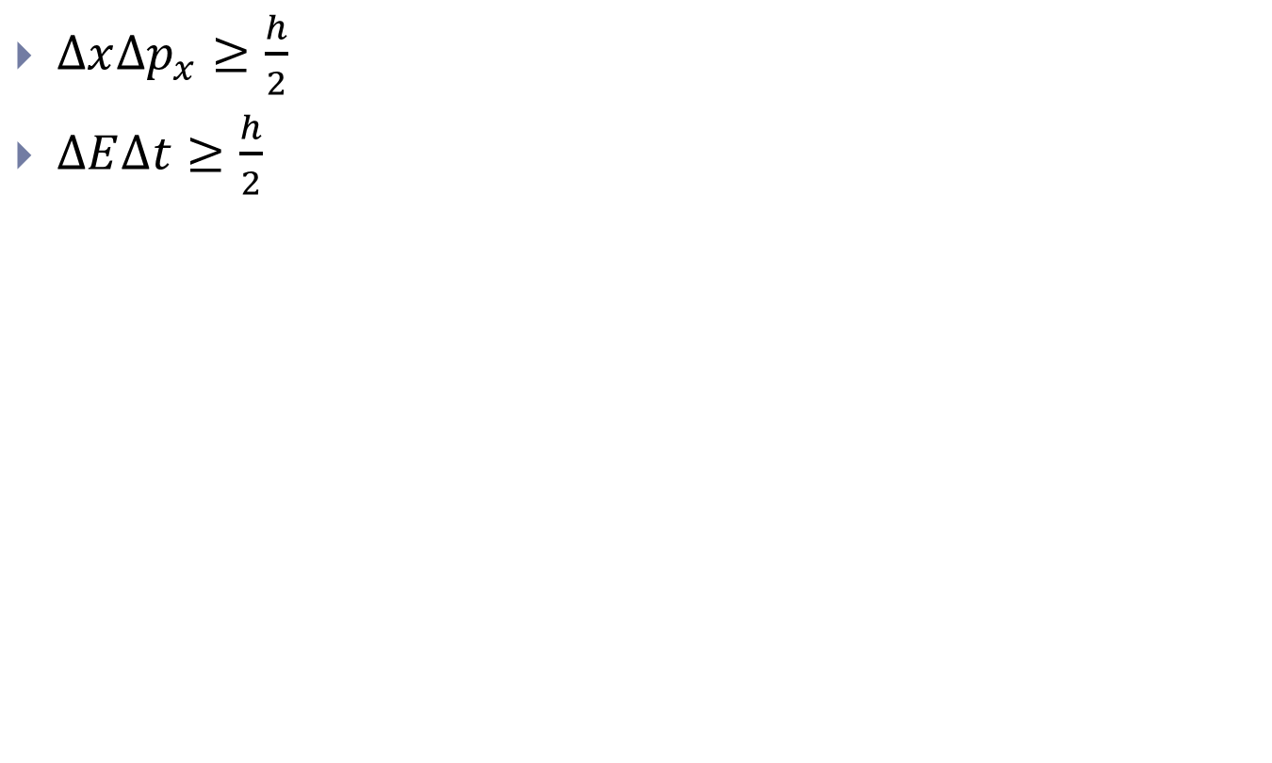
Соотношение неопределенностей
$∆x∆p_{x}≥\frac{h}{2}$
$∆E∆t≥\frac{h}{2}$

Slide 4
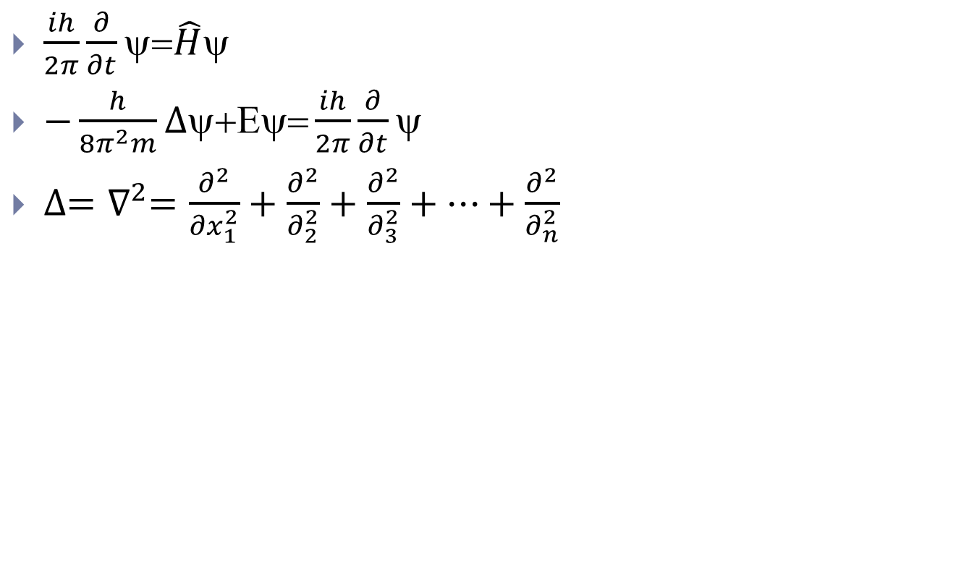
Уравнение Шредингера
$\frac{ih}{2π}\frac{∂}{∂t}\text{y}\text{=}\hat{H}\text{y}$
$−\frac{h}{8π^{2}m}∆\text{y}\text{+}\text{Ey}\text{=}\frac{ih}{2π}\frac{∂}{∂t}\text{y}$
$∆=∇^{2}=\frac{∂^{2}}{{∂x}_{1}^{2}}+\frac{∂^{2}}{∂_{2}^{2}}+\frac{∂^{2}}{∂_{3}^{2}}+…+\frac{∂^{2}}{∂_{n}^{2}}$

Slide 5
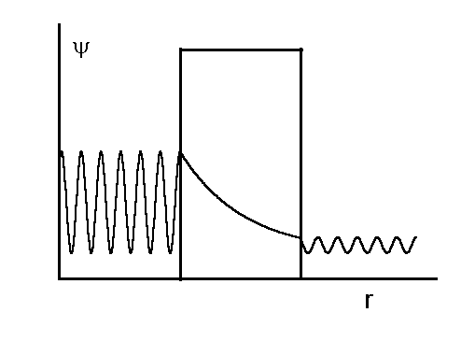
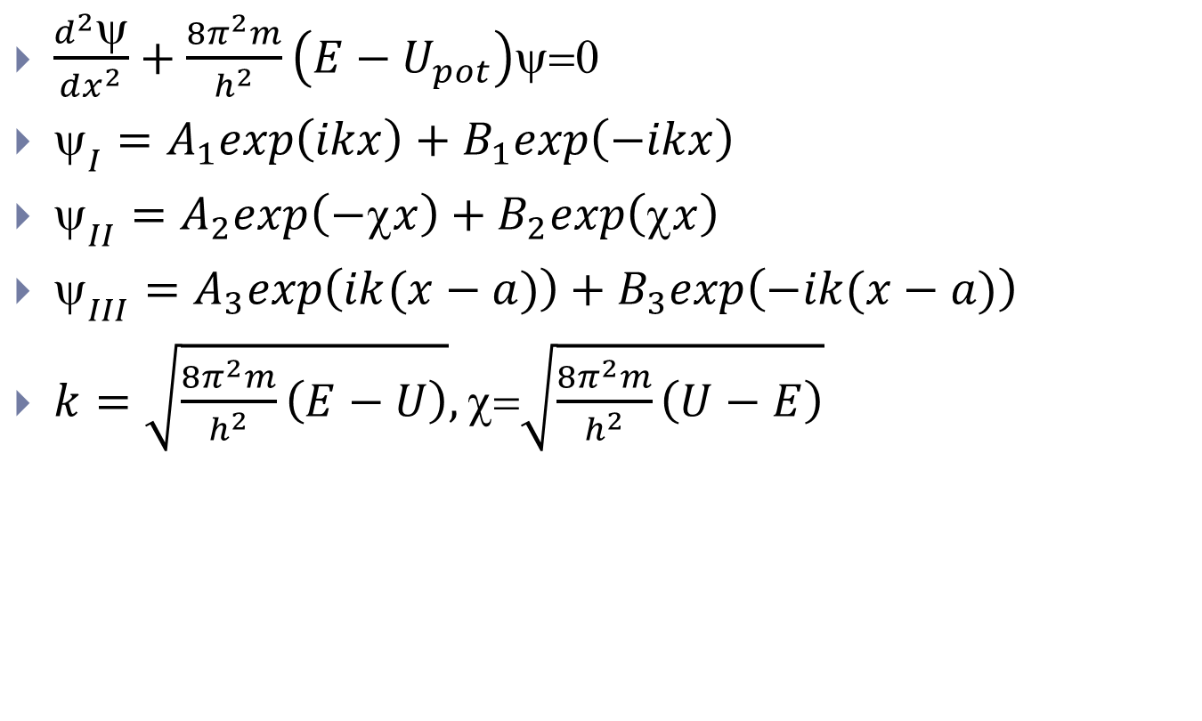
Туннельный эффект
$\frac{d^{2}\text{y}}{dx^{2}}+\frac{8π^{2}m}{h^{2}}\left(E−U_{pot}\right)\text{y}\text{=0}$
${\text{y}}_{I}=A_{1}exp\left(ikx\right)+B_{1}exp\left(−ikx\right)$
${\text{y}}_{II}=A_{2}exp\left(−\text{c}x\right)+B_{2}exp\left(\text{c}x\right)$
${\text{y}}_{III}=A_{3}exp\left(ik(x−a)\right)+B_{3}exp\left(−ik(x−a)\right)$
$k=\sqrt{\frac{8π^{2}m}{h^{2}}\left(E−U\right)},\text{c}\text{=}\sqrt{\frac{8π^{2}m}{h^{2}}\left(U−E\right)}$

