Slide 1
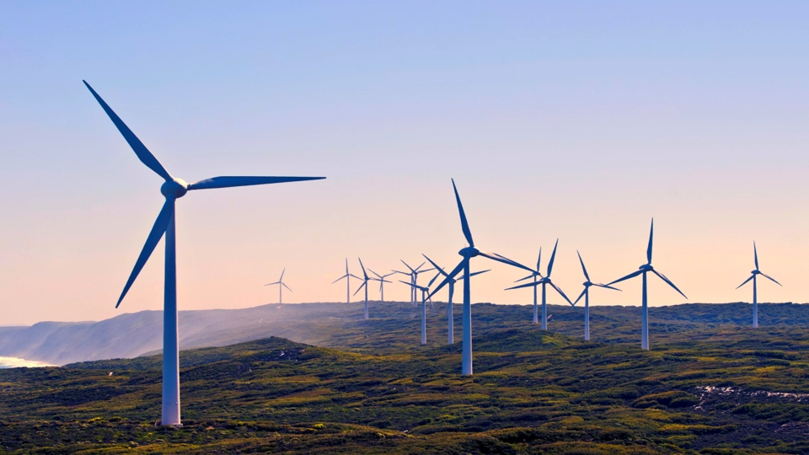
Alternative Energy Sources
Performed by:
Valieva Albina
gr.: ЭЭ-6-19

Slide 2
Solar Power
Wind Power
Solar energy is based on the conversion of solar energy, which results in electric and thermal energy. The production of electrical energy is based on the physical processes occurring in semiconductors under the influence of sunlight, the production of thermal energy is based on the properties of liquids and gases.
Wind energy is based on the conversion of the kinetic energy of air masses into electrical energy used by consumers. The basis of wind turbines is a wind generator. Wind generators differ in technical parameters, overall dimensions and design: with horizontal and vertical axis of rotation, different type and number of blades, as well as their location (land, sea, etc.).

Slide 3
Tidal Power
Hydropower is based on the conversion of the kinetic energy of water masses into electrical energy, which is also used by man for his own purposes. The objects of this type include hydroelectric power plants of various capacities installed on rivers and other water bodies. In such installations, under the influence of the natural flow of water, or by creating a dam, water acts on the blades of a turbine generating an electric current. Hydroturbine, is the basis of hydroelectric power plants. Another way of generating electric energy by converting water energy is to use tidal energy through the construction of tidal stations.

Slide 4
Geothermal energy
Geothermal energy is based on the conversion of heat emitted by the surface of the earth, both in places where geothermal waters are released (seismically dangerous territories), and in other regions of our planet. For the use of geothermal water, special installations are used, through which the internal heat of the earth is converted into thermal and electric energy. Using a heat pump allows you to receive heat from the surface of the earth, regardless of its location. His work is based on the properties of liquids and gases, as well as the laws of thermodynamics.

Slide 5
Biomass
Types of biofuels differ in methods of its production, its state of aggregation (liquid, solid, gaseous) and types of use. The indicator that unites all types of biofuels is the fact that organic products are used as the basis for their production, through which electric and thermal energy is generated. Solid biofuels are firewood, fuel briquettes or pellets, gaseous ones are biogas and hydrogen hydrogen, and liquid ones are bioethanol. , biomethanol, biobutanol, dimethyl ether and biodiesel.

