Slide 1
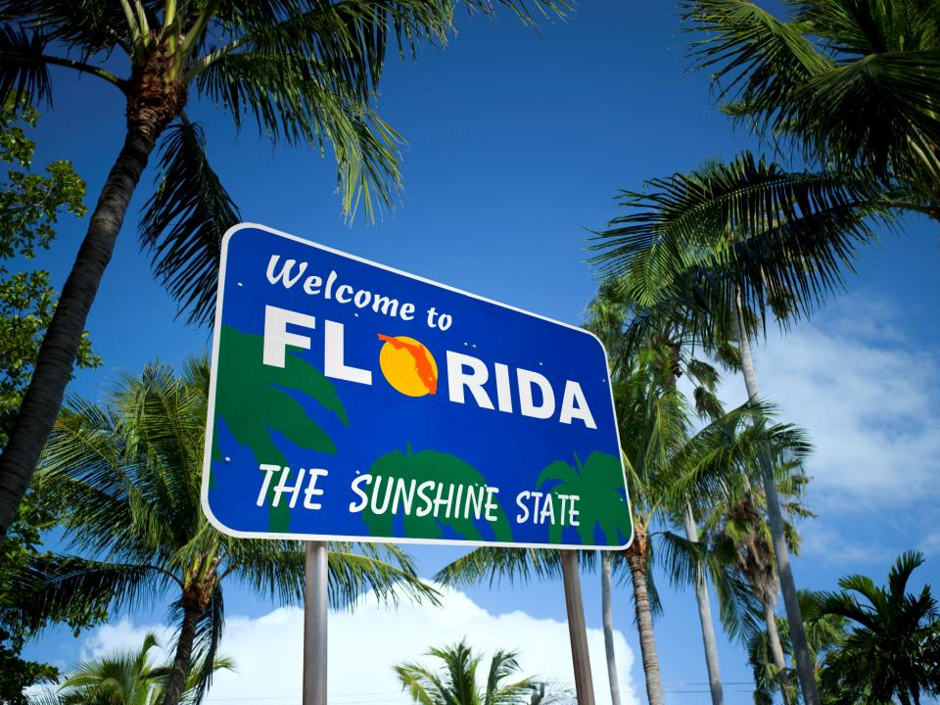
State of Florida
Презентацию подготовил
Студент 1 курса Тычкин Е.В.
Преподаватель Айтуганова Ж.И.

Slide 2
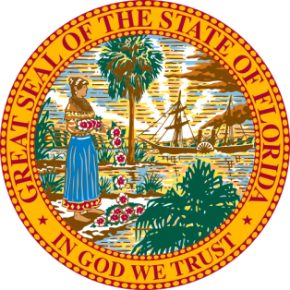
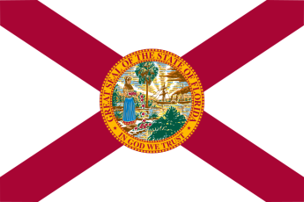
State of florida
Florida flag and seal
Nickname: The Sunshine State
Motto: In God We Trust
Capital: Tallahassee
Largest city: Jacksonville

Slide 3
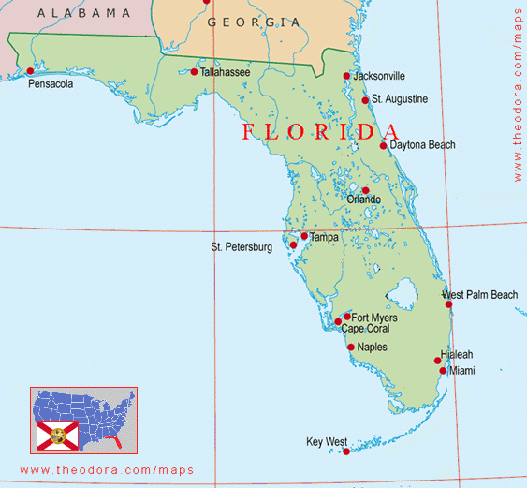
geography
Florida is bordered to the west by the Gulf of Mexico, to the northwest by Alabama, to the north by Georgia, to the east by the Atlantic Ocean, and to the south by the Straits of Florida. Florida is the 22nd-most extensive (65,755 sq mi—170,304 km²), the 3rd-most populous(20,984,400 inhabitants), and the 8th-most densely populated (384.3/sq mi—121.0/km²) of the U.S. states.
Total Area 170.000 square kilometrs.
Width: 582 km, length: 721 km.

Slide 4
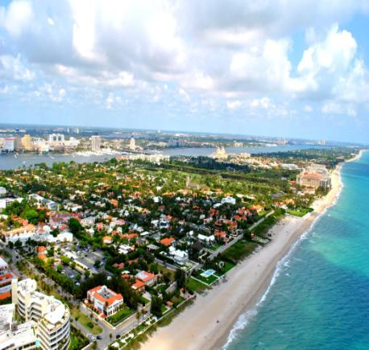
Climate
The climate of Florida is tempered somewhat by the fact that no part of the state is distant from the ocean. North of Lake Okeechobee, the prevalent climate is humid subtropical while areas south of the lake (including the Florida Keys) have a true tropical climate. Mean high temperatures for late July are primarily in the low 90s Fahrenheit (32–34 °C). Mean low temperatures for early to mid January range from the low 40s Fahrenheit (4–7 °C) in north Florida to above 60 °F (16 °C) from Miami on southward. With an average daily temperature of 70.7 °F (21.5 °C), it is the warmest state in the U.S.

Slide 5
Population
The United States Census Bureau estimates that the population of Florida was 20,271,272 on July 1, 2015, a 7.82% increase since the 2010 United States Census. The population of Florida in the 2010 census was 18,801,310. Florida was the seventh fastest-growing state in the U.S.
Florida contains the highest percentage of people over 65 (17%). There were 186,102 military retirees living in the state in 2008. About two-thirds of the population was born in another state, the second highest in the U.S.

Slide 6
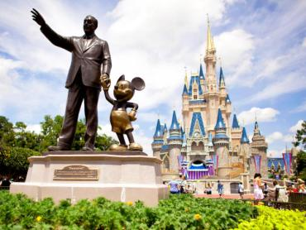
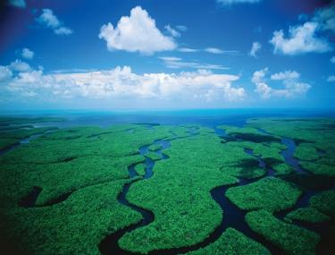
Attractions
The Everglades (National park U.S.)
St. Augustine (is a city in the Southeastern United States, on the Atlantic coast of northeastern Florida. Founded in 1565 by Spanish explorers, it is the oldest continuously occupied European-established settlement within the borders of the continental United States.)
Disney World
Palm Beach
Daytona Beach

Slide 7
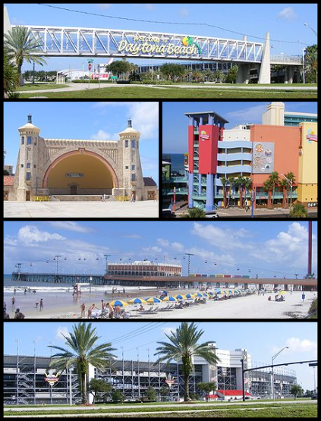
Palm beach & Daytona beach
The Town of Palm Beach is an incorporated town in Palm Beach County, Florida, United States. The Intracoastal Waterway separates it from the neighboring cities of West Palm Beach and Lake Worth. In 2000, Palm Beach had a year-round population of 10,468, with an estimated seasonal population of 30,000.
Daytona Beach is a city in Volusia County, Florida, United States. It lies about 51 miles (82.1 km) northeast of Orlando, 86 miles (138.4 km) southeast of Jacksonville, and 242 miles (389.5 km) northwest of Miami. In the 2010 U.S. Census, it had a population of 61,005. It is a principal city of the Deltona–Daytona Beach–Ormond Beach, FL metropolitan statistical area, which was home to 590,289 people in 2010. Daytona Beach is also a principal city of the Fun Coast region of Florida.

Slide 8
Thanks for watching, florida is waiting for you!

