Slide 1
Alternative energy sources

Slide 2
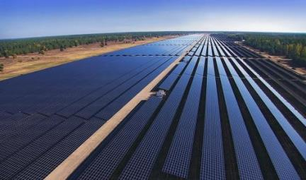
Solar power
Solar power plants
actively used in more
than 80 countries, they
Transform solar energy into electrical energy. There are different ways of such conversion and, accordingly, various types of solar power plants. The most common stations using photovoltaic converters (solar cells), combined into solar panels. Most of the world's largest photovoltaic installations are located in the USA.

Slide 3
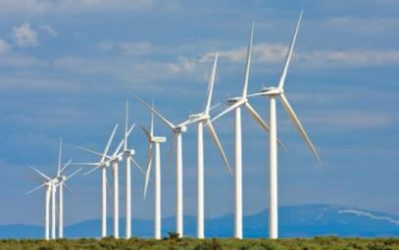
Wind energy
This is an energy industry,
specializing in kinetic
transformation energy of air masses in atmosphere into electrical, mechanical, thermal or any other form of energy convenient for use in the national economy. Such a conversion can be carried out by such units as a wind generator (for generating electrical energy), a windmill (for converting into mechanical energy), a sail (for use in transport) and others.

Slide 4
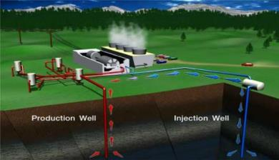
Earth's thermal energy
To develop this source energy used
Geothermal power plants, Using the energy of high temperature groundwater, as well as volcanoes. At the moment, hydrothermal energy using the energy of hot underground sources is more common. Petrothermal energy, based on the use of "dry" heat of the earth's interior, is currently poorly developed; the main problem is the low profitability of this method of generating energy.

Slide 5
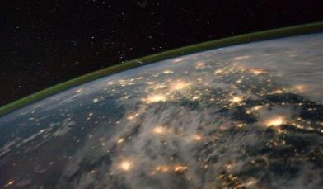
Atmospheric electricity
Thunder Energy capture based and the accumulation of lightning energy, while it is in its infancy. The main problems of lightning energy are the mobility of lightning fronts, as well as the speed of atmospheric electric discharges (lightning), which complicates the accumulation of their energy.

Slide 6
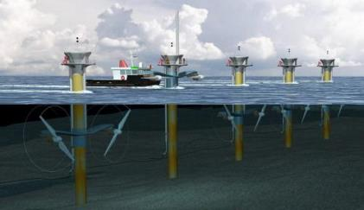
Tidal energy
A special type of hydroelectric power plant that uses the energy of tides, but in fact the kinetic energy of rotation of the Earth. Tidal power plants are built on the shores of the seas, where the gravitational forces of the Moon and the Sun change the water level twice a day.

