Slide 1
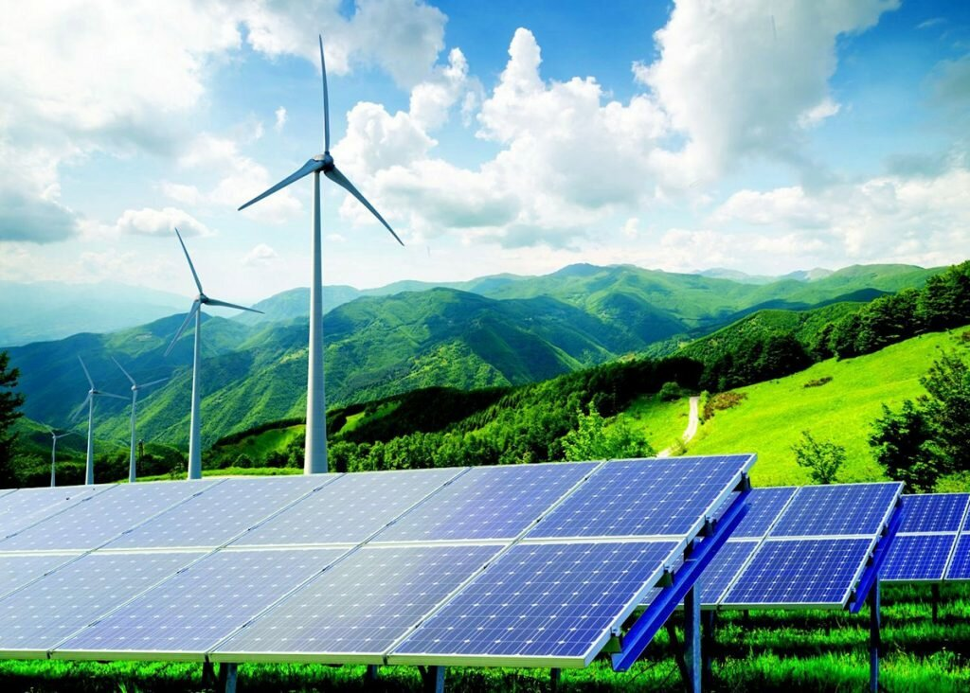
Alternative energy source.
Executed work: Tyurganova Margarita
Group ЭЭ-6-19

Slide 2
Alternative energy source – a method, device, or structure that allows you to obtain electrical energy and replaces traditional energy sources that operate on oil, extracted natural gas, and coal.

Slide 3
Types of alternative energy.
Geothermal energy
Hydropower
Wind energy
Hydrogen energy
Solar power
Bioenergetics

Slide 4
Hydropower
Wind energy
Hydropower or water power is power derived from the energy of falling or fast-running water, which may be harnessed for useful purposes.
Wind power or wind energy is the use of wind to provide the mechanical power through wind turbines to turn electric generators and traditionally to do other work, like milling or pumping.

Slide 5
Geothermal energy
Hydrogen energy
Geothermal energy is thermal energy generated and stored in the Earth. Thermal energy is the energy that determines the temperature of matter.
The hydrogen economy is the use of hydrogen as a low carbon fuel, particularly for heating, hydrogen vehicles, seasonal energy storage and long distance transport of energy.

Slide 6
Bioenergetics
Solar power
Solar power is the conversion of energy from sunlight into electricity, either directly using photovoltaics (PV), indirectly using concentrated solar power, or a combination.
Bioenergetics is a field in biochemistry and cell biology that concerns energy flow through living systems.

Slide 7
State of alternative energy in Russia.
In the 90s, due to certain events (the collapse of the USSR), many research programs in the field of alternative energy were partially or completely discontinued. Then there were attempts to start research in this direction again, and even the regions of the Russian Federation where the development of this sphere is particularly promising were identified. But despite this, in the 2000s, research in this area was almost discontinued. One of the reasons for the termination of work in this area was the high price of oil, which, in turn, discouraged the government from investing in the search for new ways to obtain energy.

Slide 8
Russia's achievements in alternative energy.
At the moment, research in the direction of "green " energy in Russia is almost not conducted, but the state has certain achievements in this area. Among these achievements, we can note the presence of a number of wind farms, as well as the presence of geothermal stations. The development of solar energy in Russia is also yielding certain fruits. there are several solar stations operating in the country. Tidal energy has also developed.

