Slide 1
Alternative Energy Sources
Mironov Rodjon ЭЭ-6-19

Slide 2
Alternative energy encompasses all those things that do not consume fossil fuel. They are widely available and environment friendly. They cause little or almost no pollution. There have been several alternative energy projects running in various countries to reduce our dependence on traditional fossil fuels. There are many impressive options that you can take into consideration

Slide 3
Solar Energy
Solar energy is one the alternative energy source that is used most widely across the globe. About 70% of the sunlight gets reflected back into the space and we have only 30% of sunlight to meet up our energy demands. While solar energy is used for producing solar energy, it is also used for drying clothes, used by plants during the process of photosynthesis and also used by human beings during winter seasons to make their body temperature warm. Solar energy can be extracted either by Solar Thermal or using Photovoltaic (PV) Cells.

Slide 4
Wind Energy
Wind power is renewable source of energy and reduces our alliance on foreign countries for supply of oil and gas. It does not cause any air pollution and have created several jobs in last few decades. Advancement in technologies has brought down the cost of setting up wind power plant. Wind energy can only be used in areas which experience high winds which mean that it cannot be used as a source to extract energy anywhere on earth. They sometimes create noise disturbances and cannot be used near residential areas. These disadvantages have made the use of wind energy to particular regions only.

Slide 5
Geothermal Energy
Geothermal energy can be found anywhere on the earth. Most countries tap this energy to generate electricity, using thermal mass flowmeters, and power millions of homes. The areas which have high underground temperatures are the ones which are the ones which are prone to earthquakes and volcanoes. The United States produces more Geothermal electricity than any other country in the world. Most hot water geothermal reservoirs are located in the western states, Alaska, and Hawaii. Geothermal energy is totally renewable as earth will continue to produce heat as long as we are all are here. If these resources are tapped and are utilized effectively, they can provide solution to the world’s power problems.

Slide 6
Hydroelectric Energy
There are different types of hydropower plants. The selection of hydropower plant depends on many volume and flow of water. Hydropower is renewable, constant, predictable and controllable source of energy. They emit no greenhouse gases and are environment friendly. On the negative side, they may cause adverse effect on aquatic life, reduce flow of water which may affect agriculture, require huge costs to build and may cause havoc if they get breakdown.

Slide 7
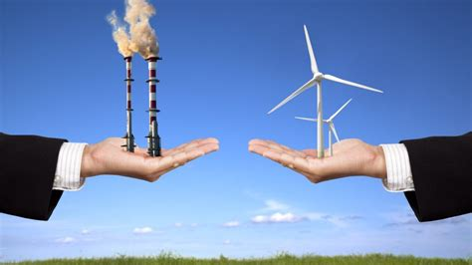
There are many reasons the world is looking for alternative energy sources in an effort to reduce pollutants and greenhouse gases. Alternative or renewable energy sources show significant promise in helping to reduce the number of toxins that are by-products of energy use and help preserve many of the natural resources that we currently use as sources of energy.

