Slide 1
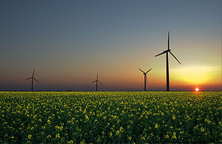
Alternative energy source
Performed by : Afanaseva Sofya gr.ЭЭ-6-19

Slide 2
Wind energy
Wind power is an energy industry that specializes in the use of wind energy — the kinetic energy of air masses in the atmosphere.
Wind power uses the force of the wind to drive the blades of wind turbines. The rotation of the turbine blades is converted to electric current by an electric generator.
Geothermal
energy
Geothermal energy is a branch of energy based on the production of electric and thermal energy at the expense of thermal energy contained in the earth 's interior, at geothermal stations. It is considered renewable energy .

Slide 3
Solar power
Solar energy is the energy of the sun , it is an almost infinite source while our star is shining. Thousands of joules of heat are streaming in our direction. Solar energy is usually used for heating, cooking, electricity generation, and even in the desalination of seawater. The sun's rays are captured by solar installations and the sunlight is converted into electricity, heat.
Bioenergetics
Bioenergy is an electric power industry based on the use of biofuels from various organic substances, mainly organic waste. Organic materials from plants or animals can be used to create energy that can be converted into electricity. Obviously, the process of burning all that 's bad for the environment, but also organic substances burn much cleaner than fossil fuels.

Slide 4
Hydropower
Hydro-energy – the energy of falling water , and ways to convert it into electricity. Generating electricity from moving water is one of the cleanest and most affordable renewable energy sources. This is a good viable option if you live on a river with a fairly steady stream.
Hydrogen
energy
Hydrogen energy is an actively developing type of energy , energy production and consumption is based on the use of hydrogen, which in turn is formed when water decomposes

Slide 5
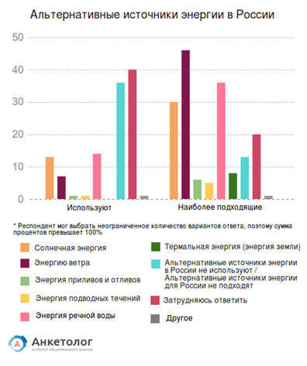
Alternative energy sources in Russia

