Slide 1
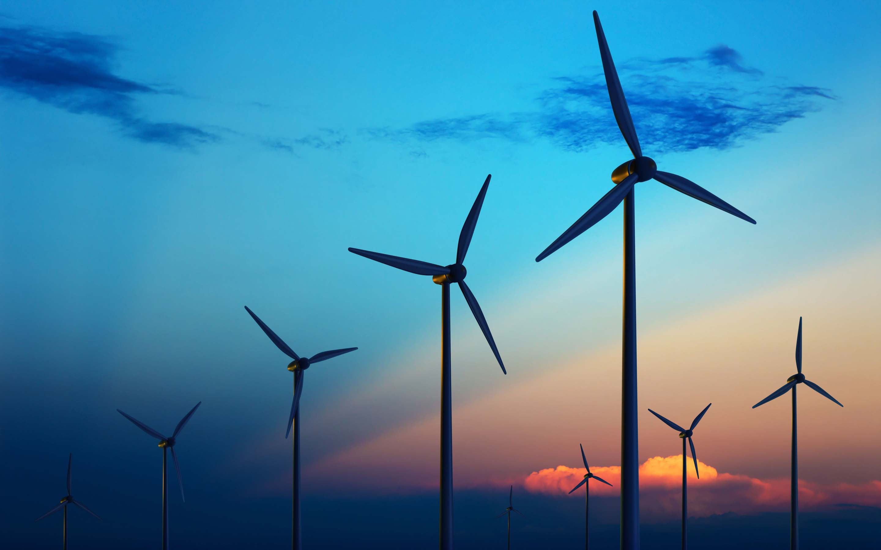
Alternative energy source
Performed by :
Alekaeva Alisa
gr. ЭЭ-6-19

Slide 2
Geothermal energy
Hydrogen energy
Alternative energy sources
Bioenergetics
Hydropower
Wind energy
Solar power

Slide 3
Hydrogen energy
Bioenergetics
Hydrogen energy is an energy industry based on the use of hydrogen as a means for storing, transporting, producing, and consuming energy. Hydrogen is chosen as the most common element on the earth's surface and in space, the heat of combustion of hydrogen is the highest, and the product of combustion in oxygen is water (which is re-introduced into the circulation of hydrogen energy). Hydrogen energy refers to alternative energy.
Bioenergy is an electric power industry based on the use of biofuels from various organic substances, mainly organic waste. Organic materials from plants or animals can be used to create energy that can be converted into electricity. Obviously, the process of burning all that 's bad for the environment, but also organic substances burn much cleaner than fossil fuels.

Slide 4
Wind energy
Solar power
This is an energy industry, specializing in kinetic transformation energy of air masses in atmosphere into electrical, mechanical, thermal or any other form of energy convenient for use in the national economy. Such a conversion can be carried out by such units as a wind generator (for generating electrical energy), a windmill (for converting into mechanical energy), a sail (for use in transport) and others.
Solar power plants actively used in more
than 80 countries, they transform solar energy into electrical energy. There are different ways of such conversion and, accordingly, various types of solar power plants. The most common stations using photovoltaic converters (solar cells), combined into solar panels. Most of the world's largest photovoltaic installations are located in the USA.

Slide 5
Hydropower
Geothermal energy
Hydro-energy – the energy of falling water , and ways to convert it into electricity. Generating electricity from moving water is one of the cleanest and most affordable renewable energy sources. This is a good viable option if you live on a river with a fairly steady stream.
Geothermal energy is a branch of energy based on the production of electric and thermal energy at the expense of thermal energy contained in the earth 's interior, at geothermal stations. It is considered renewable energy.

